Slide 1



Problem Statement
“Intel Products Sentiment Analysis from Online Reviews”
This project focuses on analyzing the sentiment of online reviews for Intel's products. By examining customer feedback, we can gain valuable insights into how people perceive and experience Intel's offerings, helping the company improve its products and services.
Nominator Name: Dr. Shrinivasrao B. Kulkarni
Mentor Name: Dr. Archana Nandibewoor
Institute Name: Shri Dharmasthala Manjunatheshwara College of Engineering and Technology, Dharwad.
Team Name: Brainiacs Team Members:
Ananya Dayanand Prabhu
Neha Vithob Nayak
Pooja S Doddagoudar

Slide 2



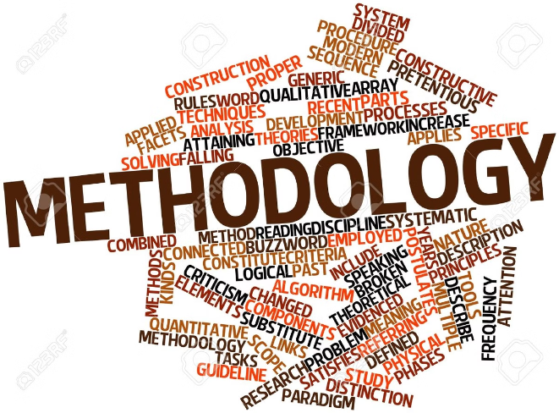



Methodology:
Web Scraping
Collect online reviews for Intel products from various e-commerce and review sites using automated web scraping techniques.
Data Cleaning
Preprocess the scraped data by removing irrelevant information, handling missing values, and normalizing the text.
Sentiment Analysis
Apply natural language processing and machine learning algorithms to classify the sentiment of each review as positive, negative, or neutral.
Model Training
Train a sentiment analysis model using the labeled review data, optimizing its performance through iterative refinement.

Slide 3




Data Collection
Data Preprocessing
Sentiment Analysis
Gather online reviews for Intel products from various e-commerce and review platforms.
Clean and structure the raw review data to prepare it for sentiment analysis.
Utilize natural language processing techniques to determine the sentiment (positive, negative, or neutral) of each review.

Slide 4

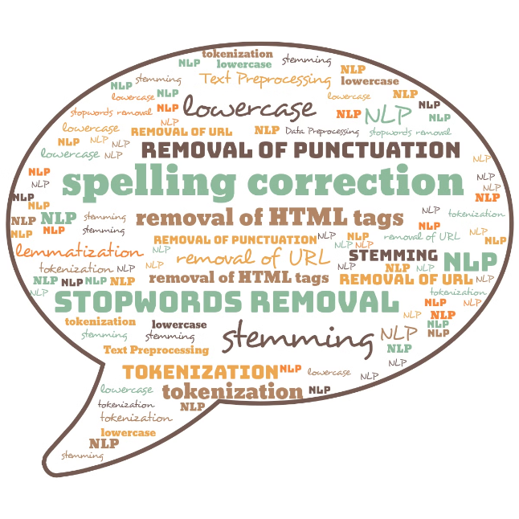



Text Processing
Tokenization
Break down the review text into individual words or tokens for further processing.
Stopword Removal
Eliminate common, non-informative words that do not contribute to the sentiment analysis.
Lemmatization
Reduce words to their base or dictionary form to improve the accuracy of sentiment classification.

Slide 5


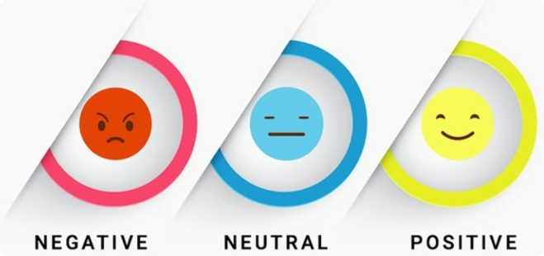


Sentimental Analysis
Positive
Identify reviews expressing favorable opinions, satisfaction, or praise for Intel products.
Negative
Detect reviews expressing dissatisfaction, criticism, or complaints about Intel products.
Neutral
Classify reviews that do not convey a clear positive or negative sentiment towards Intel products.

Slide 6
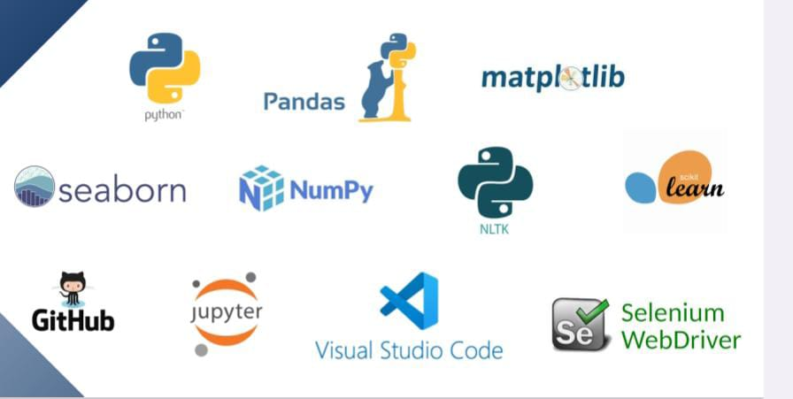
Techonologies used

Slide 7
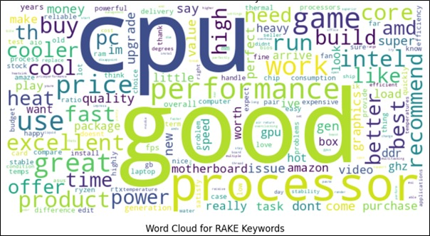
Features offered
Keyword Abstraction

Slide 8
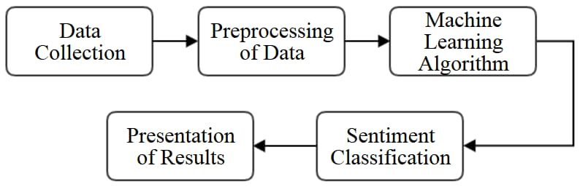
Architecture Diagram

Slide 9
Implementation
Project Overview : The Intel Products Sentiment Analysis Project aimed to leverage advanced Natural Language Processing (NLP) techniques to extract valuable insights from user reviews on Amazon. By systematically collecting, preprocessing, analyzing, and visualizing review data, we sought to understand customer sentiments and identify key areas for product improvement.
Key Achievements Data Collection and Preprocessing : Successfully collected a substantial dataset of user reviews from Amazon using web scraping techniques.Cleaned and preprocessed the text data to ensure consistency and usability, removing HTML tags, special characters, and unnecessary whitespace.

Slide 10
Sentiment Analysis :
Implemented two sentiment analysis models :
VADER (Valence Aware Dictionary and sEntiment Reasoner): Provided initial sentiment classification using a lexicon-based approach.
RoBERTa (Robustly optimized BERT approach): Employed for more advanced sentiment analysis, classifying sentiments into categories with associated probabilities.Combined the sentiment scores from both models to enhance accuracy and reliability, assigning final sentiment labels to each review.
Keyword Abstraction : Extracted important keywords from reviews using two methods:TF-IDF (Term Frequency-Inverse Document Frequency): Identified the most significant words in the reviews.RAKE (Rapid Automatic Keyword Extraction): Extracted key phrases and terms associated with different sentiment clusters.Generated word clouds to visualize the most important keywords, providing a clear summary of the key topics discussed in the reviews.
Exploratory Data Analysis (EDA):Visualized the distribution of ratings and sentiment scores to understand overall customer satisfaction and sentiment trends.Conducted time series analysis to identify trends and seasonal patterns in customer feedback.

Slide 11
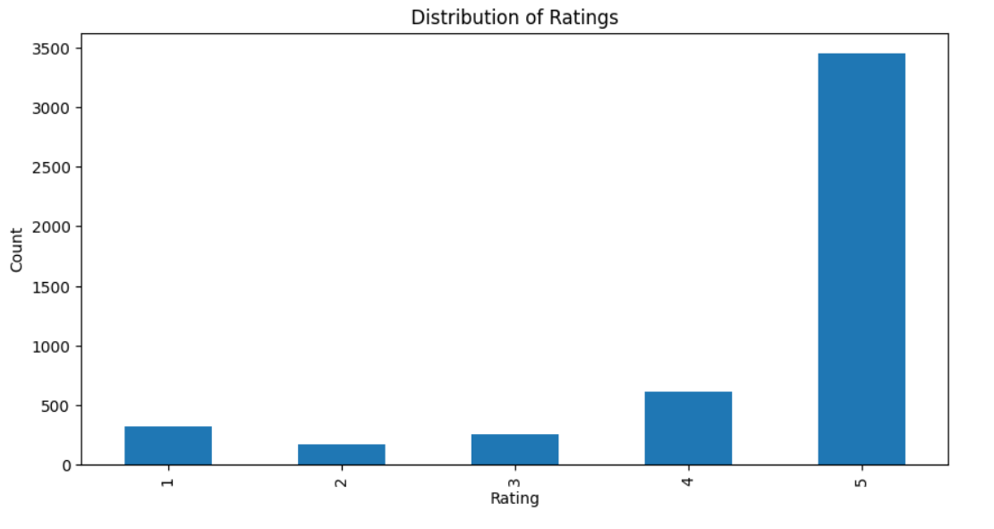
Ratings distribution chart

Slide 12
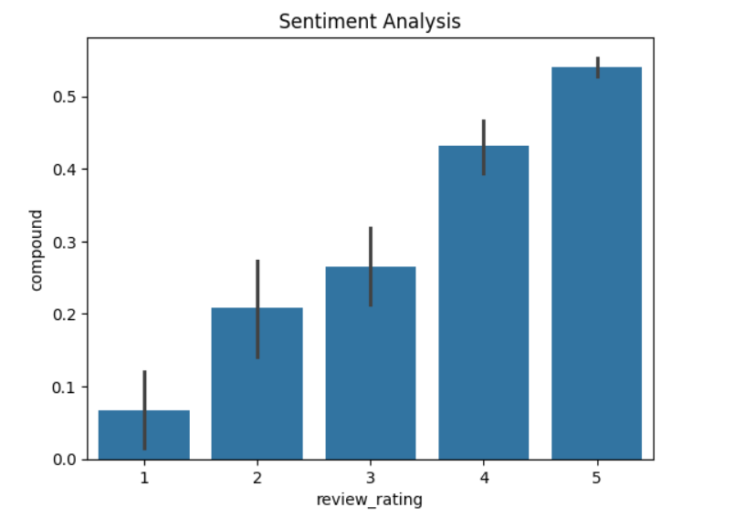
Sentiment analysis chart

Slide 13
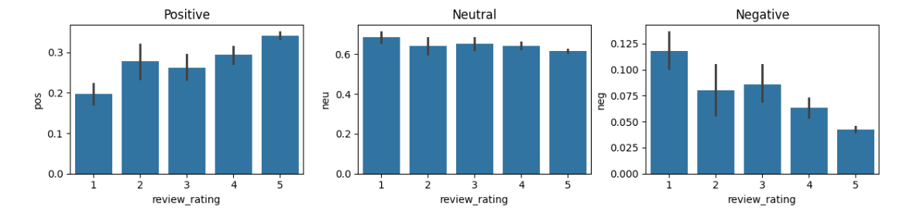
Review rating chart

Slide 14
Team members and their contribution
web scrapping : Done by Neha V and Ananya D .
data preprocessing : Done by Pooja S and Ananya D .
Analysis : Done by Neha V , Pooja S and Ananya D .
Extra feature : Done by Neha V and Pooja S .
Presentation : Done by Pooja S .
Report : Done by Neha V and Ananya D .

Slide 15
Conclusion
The Intel Products Sentiment Analysis Project successfully leveraged NLP techniques to gain valuable insights from user reviews.
By combining sentiment analysis, keyword abstraction, and exploratory data analysis, we provided a comprehensive understanding of customer sentiments and identified key areas for product improvement.
The project highlighted the importance of monitoring customer feedback and continuously improving products to enhance customer satisfaction.

